Slide 1
Machine Learning

Slide 2
What is Machine Learning?

Slide 3
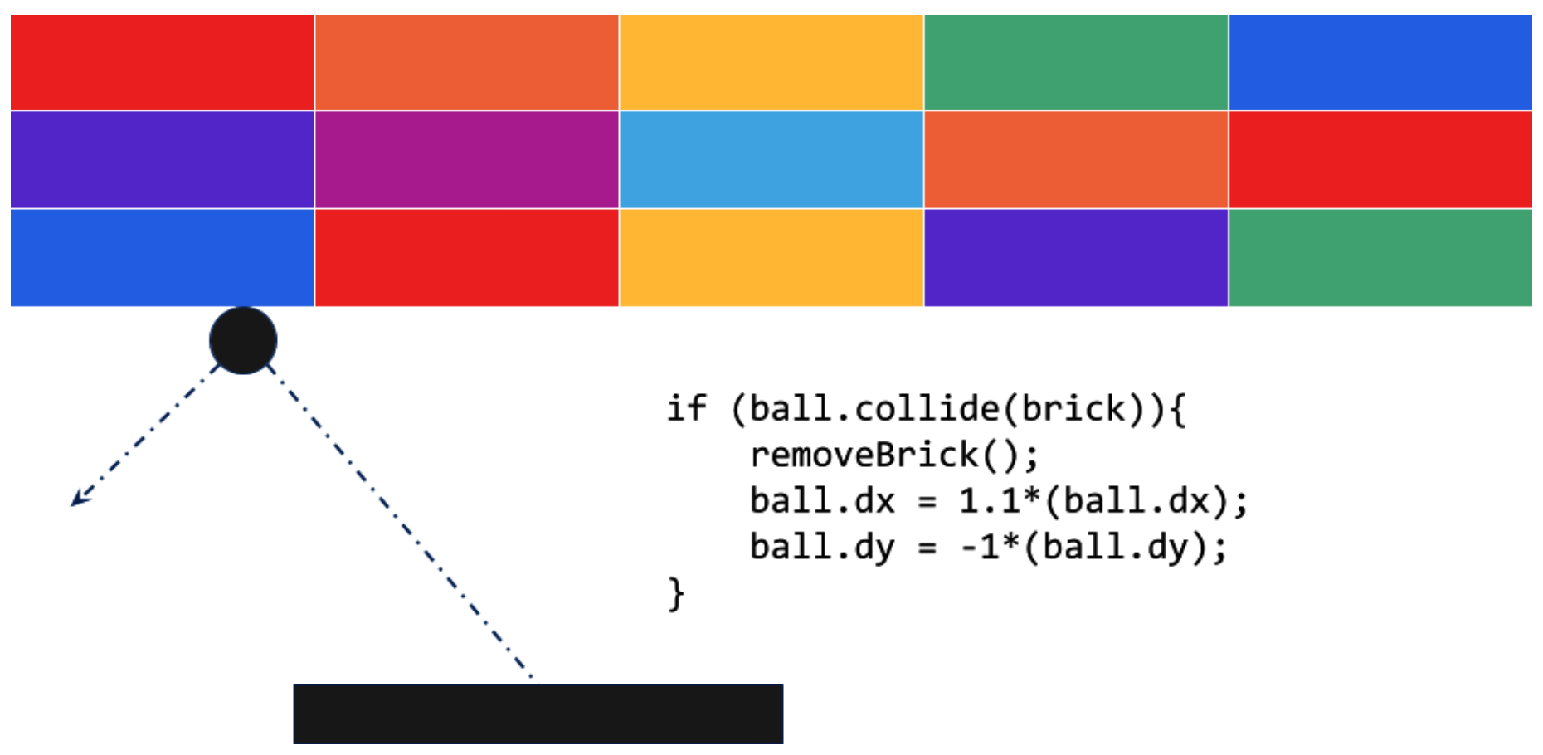
Traditional Programming
Notes:
Popular Breakout Game
Here, the motion of the ball can be determined by its dx and dy properties. When it hits a brick, the brick is removed, and the velocity of the ball increases and changes direction. The code acts on data about the game situation.

Slide 4
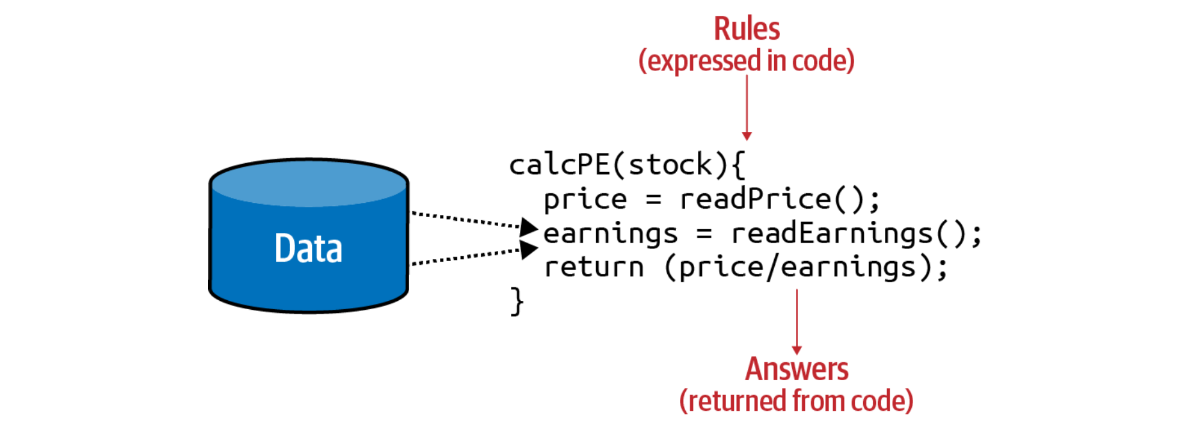
Traditional Programming
Notes:
You have data about a company’s stock, such as its current price and current earnings. You can calculate a valuable ratio called the P/E (for price divided by earnings).

Slide 5
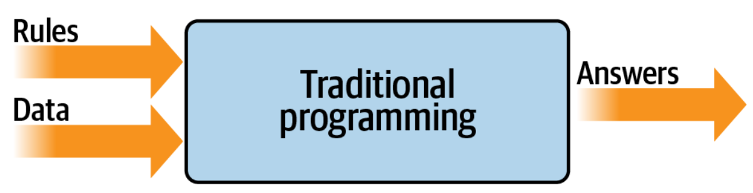
Traditional Programming
Notes:
You have rules expressed in a programming language. These rules act on data, and the result is answers.

Slide 6
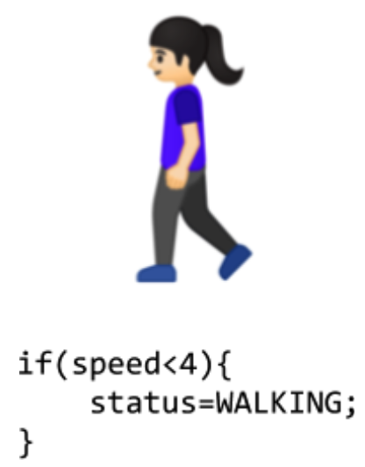
Limitations Traditional Programming
Notes:
Consider, for example, activity detection. Fitness monitors that can detect our activity are a recent innovation, not just because of the availability of cheap and small hardware, but also because the algorithms to handle detection weren’t previously feasible.

Slide 7
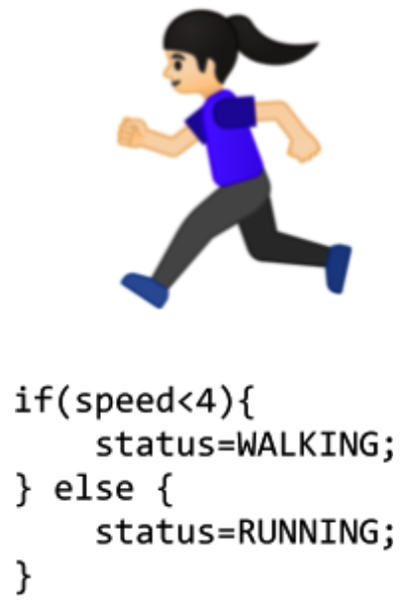
Limitations Traditional Programming

Slide 8
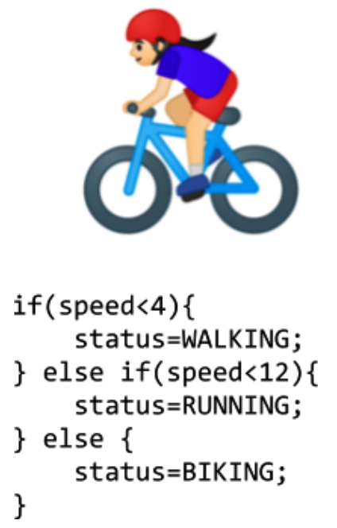
Limitations Traditional Programming

Slide 9

Limitations Traditional Programming
Notes:
We’re now stuck. How do we determine that someone is golfing using this methodology? The person might walk for a bit, stop, do some activity, walk for a bit more, stop, etc. But how can we tell this is golf?

Slide 10
From Programming to Learning
Notes:
We have rules that act on data and give us answers. In our activity detection scenario, the data was the speed at which the person was moving; from that we could write rules to detect their activity, be it walking, biking, or running. We hit a wall when it came to golfing, because we couldn’t come up with rules to determine what that activity looks like.

Slide 11
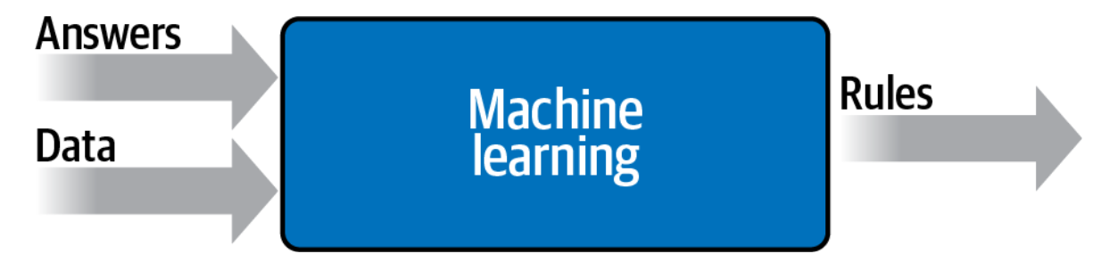
From Programming to Learning
Notes:
Instead of us trying to figure out what the rules are, we get lots of data about our scenario, we label that data, and the computer can figure out what the rules are that make one piece of data match a particular label and another piece of data match a different label.

Slide 12
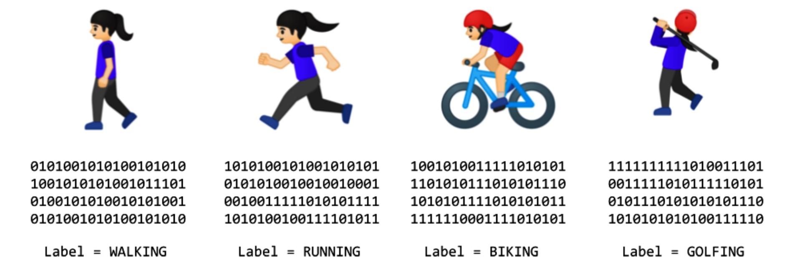
From Programming to Learning
Notes:
We can look at all the sensors that give us data about this person. If they have a wearable that detects information such as heart rate, location, speed, etc.—and if we collect a lot of instances of this data while they’re doing different activities—we end up with a scenario of having data that says “This is what walking looks like,” “This is what running looks like,” and so on.
Now our job as programmers changes from figuring out the rules, to determining the activities, to writing the code that matches the data to the labels. If we can do this, then we can expand the scenarios that we can implement with code. Machine learning is a technique that enables us to do this.

Slide 13
Machine Learning
Supervised Learning - is a machine learning approach that’s defined by its use of labeled datasets.
Unsupervised Learning - uses machine learning algorithms to analyze and cluster unlabeled data sets.
Reinforcement Learning - is a machine learning training method based on rewarding desired behaviors and punishing undesired ones. In general, a reinforcement learning agent -- the entity being trained -- is able to perceive and interpret its environment, take actions and learn through trial and error.

Slide 14
Supervised Learning
Regression
Linear Regression
Logistic Regression
Polynomial Regression
Classification
Linear Classifier
Support Vector Machines
Decision Trees
Random Forest

Slide 15
Unsupervised Learning
Clustering
Association

Slide 16
Reinforcement Learning
Robotics
Self-driving cars

